Slide 1
Capitalism, Alone—endogenous forces of income increase
Branko Milanovic
Berlin November2023

Slide 2
Structure of the talk
1. Defining various types of capitalism
2. The facts: systemic inequalities in meritocratic/liberal capitalism
3. The outcome: shrinking middle class
4. The policy: What to do?

Slide 3
1. Defining various capitalisms in function of distribution of labor and capital incomes

Slide 4
Income distribution in classical capitalism
Number of people
Workers
Capitalists
Income

Slide 5
Income in classical capitalism
Capital income
Income level (in logs)
Labor income
People ranked by total income

Slide 6
Income in meritocratic capitalism
Capital income
Income level (in logs)
Labor income
People ranked by total income

Slide 7
2. The facts: Six systemic inequalities in meritocratic/liberal capitalism

Slide 8
Six systemic inequalities in liberal/meritocratic capitalism
1. Increasing aggregate share of capital in national income
2. High concentration of capital ownership
2a. Higher rate of return on the assets of the rich
3. Association of high-capital and high-labor incomes in the same individuals (homoploutia)
4. High homogamy (assortative mating)
5. High control of the political process by the rich (movement toward plutocracy)
6. Greater transmission of income and wealth across generations

Slide 9
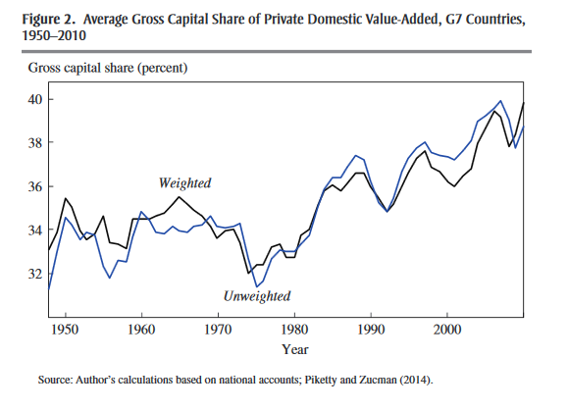
1. Increasing (macro) capital share
From Matthew Ronglie

Slide 10
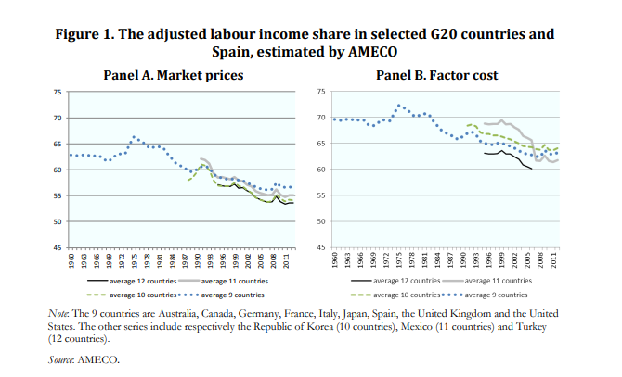
Labor share in net income went down by about 10 percentage points
Source: ILO, OECD, “Labor share in G20 economies” 2015

Slide 11
2. Capital income is heavily concentrated among the rich
A rising capital share means a rising importance of an unequal source of income (income from capital)
Therefore, rising capital share tends to quasi-automatically spill over into a higher inter-personal inequality.
Functional income distribution => inter-personal income distribution

Slide 12
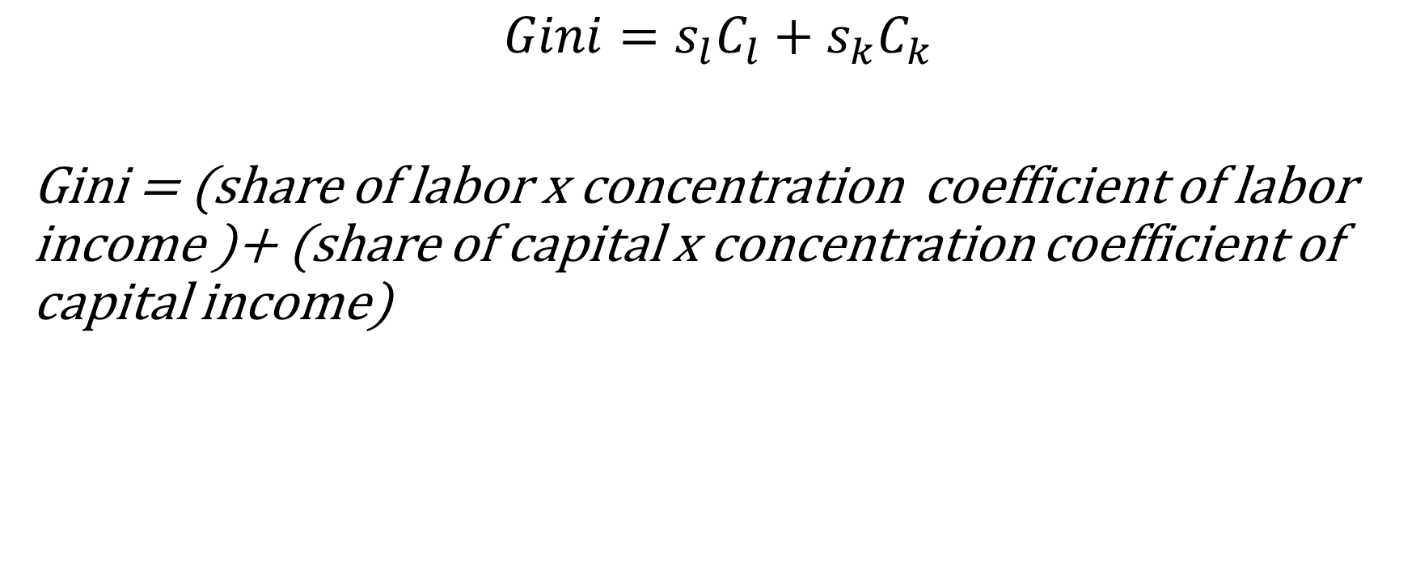
A simple inequality decomposition formula
$${Gini=s}_{l}C_{l}+{s_{k}C}_{k}$$
Gini = (share of labor x concentration coefficient of labor income )+ (share of capital x concentration coefficient of capital income)

Slide 13
USA, 1974-2020
Germany, 1984-2019
Norway, 1979-2020
UK, 1979-2020

Slide 14
US-others-K-L.xls in voter files
Red: amount; blue: share

Slide 15
2a. Higher rate of return on the assets of the rich: composition effect….
80% of gross assets of the rich are financial instruments vs. only 12% for the middle class

Slide 16
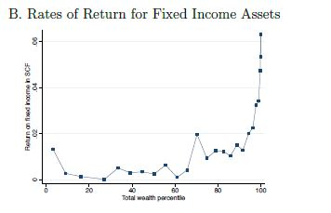
….but also higher returns within asset-classes
Eric Zwick, Top income wealth in the United States, draft, 2019.

Slide 17
3. Homoploutia: High K and L income received by the same people
US_others_K_L.xls
LIS data

Slide 18
H
O
M
O
P
L
O
U
T
I
A
Classical capitalism
US_others_L_L.xls

Slide 19
Two applications of homoploutia and one question
How much of inequality increase is due to homoploutia? What are the drivers of homoploutia?
How homoploutia can help us classify and understand various capitalisms
More speculative: does homoploutia make social mobility less and fight against inequality more difficult? Or is it a dramatic improvement upon classical capitalism?

Slide 20
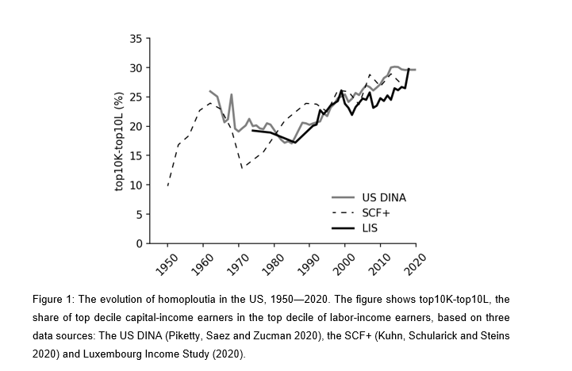
United States: Homoploutia 1960-2020
Berman and Milanovic, 2020

Slide 21
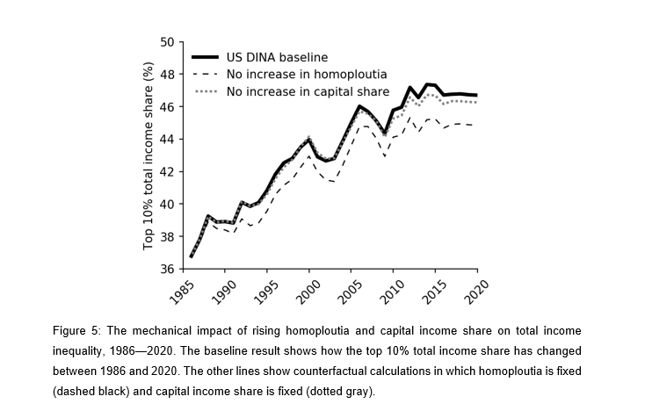
Homoploutia accounts for 1/5 of the increase in US inequality between 1985 and 2020
The effect of homoploutia
Berman & Milanovic 2021

Slide 22
4. Homogamy (assortative mating): rich males (cohorts)
From Nishant Yonzan

Slide 23
3. The outcome: Shrinking middle class in both market and disposable income shares

Slide 24
Smaller size of western middle classes
Define_variables.do using c:\branko\voter\dofils\define_variables using data_voter_checked.dta

Slide 25
Greater inequality of market income only in part compensated by greater redistribution
Branko\VOTER\datafiles\data_voter_new.dta and define.variables.do

Slide 26
11 points
11 points
Branko\VOTER\datafiles\data_voter_new.dta and define.variables.do

Slide 27
ranko\VOTER\datafiles\data_voter_new.dta and define_vsarables.do

Slide 28
ranko\VOTER\datafiles\data_voter_new.dta and define_vsarables.do

Slide 29
4. Policy: how to change it?

Slide 30
Policy
Rich countries can expect to have an ever greater K/Y ratios. Unless r drops proportionally, capital share is likely to continue to rise.
With the current K and L endowments, that implies a pass-through rate whereby each additional point in K share translates into about ½ Gini point increase in personal income inequality. Is this sustainable, if e.g. the share of capital goes up by 10 points?
Technically the link can be weakened by increased taxation of income from capital (flow) or wealth (stock)
Both would reduce Gini of capital income and reduce the pass-through to inter-personal inequality
But four key tools of inequality reduction from the 20th century are weaker now: education, trade unions, taxes, social transfers
So what are the solution?

Slide 31
Capital: more widely owned
But the question is to what extent are higher taxes on capital flows or capital stocks feasible in the era of globalization. Require very high level of inter-state coordination and is difficult to enforce.
An alternative would be to focus on “pre-redistribution”, that is on reducing the concentration of capital endowments through much more widely spread ownership.
Could be done through workers’ shareholding (ESOPs), but they have a problem of non-diversification of risk (although that issue is somewhat exaggerated) or
through greater incentives for small savers and investors and penalties (elimination of loopholes) for large investors.
Or inheritance taxation.
The key point is to increase capital ownership for some 80% of people who currently own 10% of all wealth (including housing).

Slide 32
Systemic inequalities in liberal/meritocratic capitalism and policy actions
Systemic inequality | Possible remedy
Increasing aggregate share of capital in national income | Demonopolization, stronger unions
High concentration of capital ownership | Deconcentration through tax advantages to the middle class, ESOPs, worker ownership Elimination of loopholes for the rich
Higher rate of return on the assets of the rich | Increased taxation of K gains
Homoploutia | Nothing
Homogamy | Nothing
Control of the political process by the rich | Electoral reform
Greater transmission of income and wealth across generations | Taxation of inheritance Public education (Rawls liberal equality)

